Slide 1
1 Introduction to Operating Systems
Operating System Zoo Operating System Concepts System Calls Operating System Structure

Slide 2
Objectives
Introduction to OSs
Hardware review
The Operating System Zoo
Mainframe OS
Server OS
Multiprocessor OS
PC OS
Handheld Computer OS
Embedded OS
Sensor Node OS
Real-Time OS
Smart Card OS

Slide 3
Objectives…
OS: Concepts
Processes
Address Spaces
Files
I/O
Protection
The Shell
Ontogeny Recapitulates Phylogeny (tóm tắt sự phát sinh các OS)
System Calls
OS Structures
Monolithic Systems – hệ thống nguyên khối
Layered Systems
Microkernels
Client – Server Models
Virtual Machines

Slide 4
1- Introduction to Operating Systems

Slide 5
Operating System: Context
Why do we install an OS before we want to use and control/ manipulate our computer/device?
How do we manipulate the computer hardware (RAM, Disks, AGP card, Audio card, Keyboard, etc …)?
How can our computer run many programs at the time without being worried about finitely RAM, one or two CPU? Do they run in parallel or in sequence order?
How can our computer allocate resources to many running programs at the time?
What’s the OS’s role in our computer? What’s it’s main functions? Which problems do our computers take without the present of OSs? Is the OS software or hardware?

Slide 6
OS: Context
The basic question is “What is the OS?”
The important questions are:
Why do we learn OS?
What are the constraints between applications and OS?

Slide 7
OS: Overview
Shell and Applications
Operating System
Hardware
User mode
Software
Kernel mode (supervisor mode)
Where the operating system fits in.

Slide 8
OS: Definitions
Harware: physical elements such as CPU, mainboard, rom, ram, harddisk, USB flash drive, …
Softwares: Programs that access and control hardware.
System sofwares: The most basic software must be installed to a family of computers to make them ready to use.
Application sofwares: softwares are developed based on user requirements and can execute on a specific system software. Programs support utilities forn users such as MS Powerpoint, MS Word, games,…
➔ OS is a system software

Slide 9
OS: Functions/Roles
OS is concerned as an extended machine. It hides complexities when hardwares are accessed.
It is a resource manager.
➔It includes a collection of procedures that:
Manage all the system’s hardware resources
Provide the users the environment in which they can
Use the system resources
Run their own applications

Slide 10
Operating System: Goals
Execute user programs (mostly for ease of use with performance)
Make the hardware efficiently and convenient to use
Controls and coordinates the use of hardware among the various application programs for various users
Hides the peculiarities (sự khác biệt) of hardware accessing such as disk or I/O device reading/writing.

Slide 11
OS: Termilologies
Instruction context: a task that hardware must carry out. A current instruction can belong to OS (kernel mode) or a running application (usermode).
Kernel mode/Supervisor mode (OS runs in this mode)
Gains control of the computer to access all the hardware
Can execute any machine instructions
Supports security: Protects the OS from errant users (giang hồ).
Everything running in this mode is a part of the OS or closely associated with it.
User mode (The user softwares run in this mode)
Can execute a subset of the machine instructions with the exception of instructions to control of the machine or do I/O
Mode switching
If the user interacts with OS: user mode → kernel mode
If the system passes control to a user program: kernel mode → user mode

Slide 12
Lab Guilines
Download guilines and helps from the CMS
Lab Guidelines
Setup VMware
Setup Fedora
Setup MC tool
Setup Fedora Eclipse

Slide 13
2- Hardware Review

Slide 14
Hardware: Von Neumann Architecture
Multipurpose machine with following characteristics:
Instruction cycle: Fetch-Decode-Execute
Instructions and data are stored in main memory
Instruction execution carried out by central processing unit (CPU)

Slide 15
Hardware :Von Neumann Architecture…
Breakdown of typical fetch-decode-execute cycle:
Control unit uses the address in program counter register to fetch an instruction from main memory
Instruction decoded
Any needed data retrieved from memory and placed into other registers
ALU executes the instruction using data in registers, if necessary
Input or output operations required by the instruction are performed

Slide 16
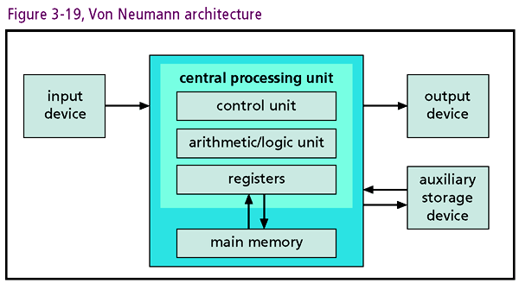
Hardware: Structure

Slide 17
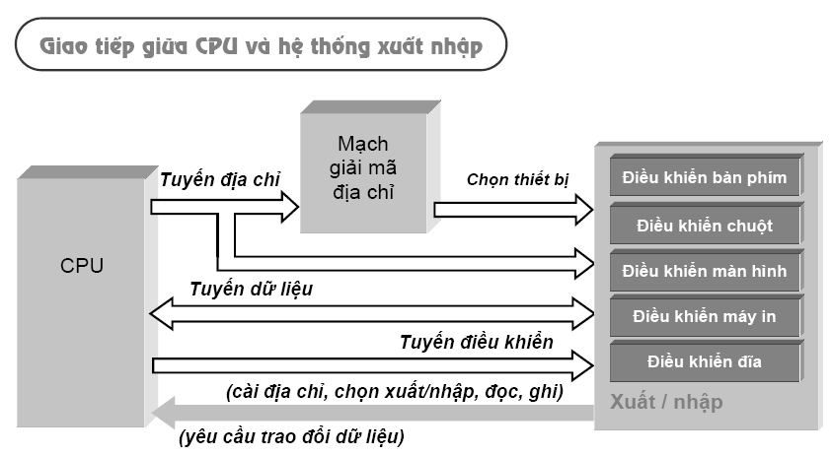
Hardware: Buses

Slide 18
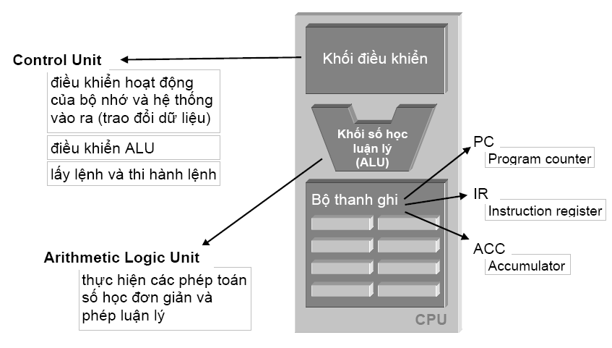
Hardware: CPU Structure

Slide 19
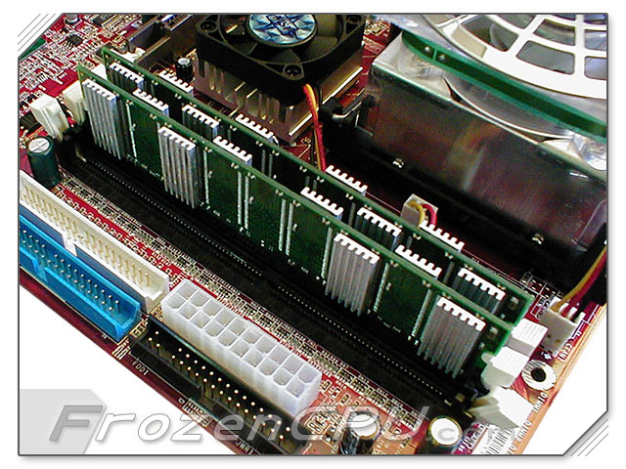
Hardware: Storage
Storage: family of components used to store programs and data
Storage hierarchy
Primary memory
Secondary memory
(mass storage)

Slide 20
Hardware: Memory
Two basic flavors
ROM (read-only memory)
Memory etched into chip
Generally cannot be modified
BIOS (basic input/output system) in this category
RAM (random access memory) basics
Allows direct memory reference
Allows reading and writing
Volatile
CPU fetches program instructions from RAM
Notes:
Etch: nhét vào

Slide 21
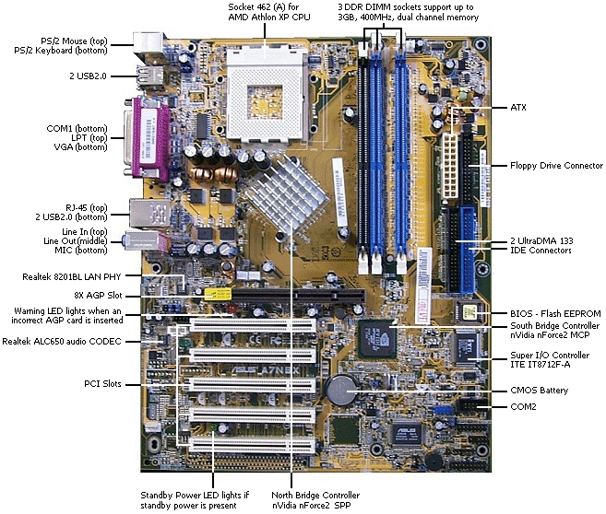

Hardware-Memory: Rom & Ram
Notes:
Etch: nhét vào

Slide 22
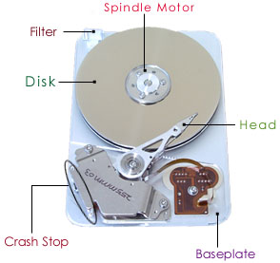
Hardware: Disks
Hard disk drives
Most common form of mass storage
Magnetic metal platters store information
Organized into concentric circles called tracks
Tracks divided into sectors
Platters spin at about 7200 RPM
Read/write heads interface with disk surface
Low cost-unit storage ratio relative to RAM
RAID (Redundant Array of Independent Discs)

Slide 23
Hardware: Disks…
Optical Storage
Popular formats: CDs (compact disks) and DVDs (digital video disks)
Stores data using optical (laser) technologies
Pits burned into disks interpreted as binary data
Data written to disks in continuous spiral
Like hard disks, CDs and DVDs spin
Read/write heads interface with disk surface
Low cost-unit storage ratio

Slide 24
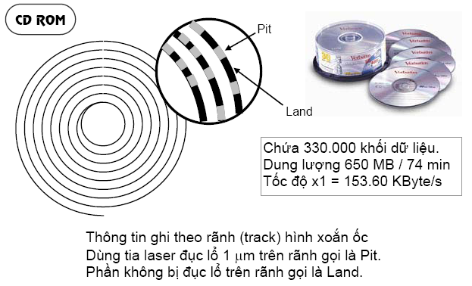
Hardware: : Optical Storage…

Slide 25
Hardware: Input/Output Systems
Final component of Von Neumann architecture
Input/Output (I/O) devices: computer’s connection to user

Slide 26
Hardware: Input Devices
Keyboard
Chief input device for most users
Connected to motherboard through port and then to CPU by controller circuit and system bus
Keystrokes are translated into binary signals for CPU consumption
Mouse
Used in conjunction with keyboard
Senses movement that can be translated into binary code
Other devices: trackballs, styluses, touch pads/screens

Slide 27
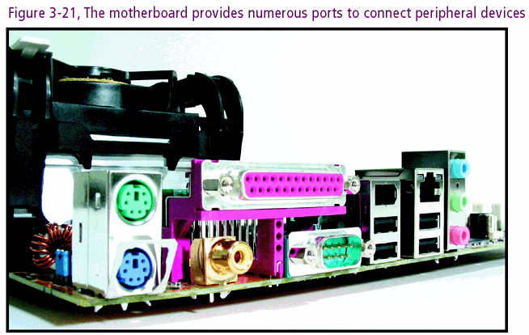
Hardware: Input Devices

Slide 28
Hardware: Output Devices
Communication channel to outside world
Monitors
Primary output device
CRTs (cathode ray tubes)
Utilizes raster scanning techniques
Quality based on resolution and refresh rate
LCD (Liquid Crystal Display)
Thinner and cooler than CRTs
Utilizes transistors rather than electron beams
Quality based on resolution and refresh rate

Slide 29
Hardware: Output Devices…
Printers
Important output device
Chief varieties: ink jet and laser printers
Quality measured by resolution (dots per inch) and speed (pages per minute)
Sound cards
Fit into PCI expansion slot on main board
Used to digitize sound for storage
Also converts binary sound files into analog sounds

Slide 30
Hardware: Interrupts and Polling
How the CPU knows signals from IO?
CPU instruction cycle equals clock speed
CPU commits to cycle based on processing need
Processing need determined by (2) techniques
Polling (quét dò tìm định kỳ): CPU interrogates I/O device
Interrupt Handling (báo tín hiệu ngắt): I/O device initiates request for service
Notes:
Pooling: bỏ phiếu – dò tìm
Interrogate: thẩm vấn

Slide 31
3- The Operating System Zoo
Read yourself
Complexity
Mainframe OS
Server OS
Personal Computer OS
Handheld Computer OS
Embedding OS
Sensor Node OS
Real-time OS
Smart Card OS
+
-

Slide 32
OS Zoo: Mainframe OS
Mainframe: A type of large computer system.
Are heavily oriented toward processing many jobs at once, most of which need prodigious (phi thường) amounts of I/O.
Offers 3 kinds of services
Batch ( xử lý theo lô): a chain of pre-defined jobs
Transaction processing: All or nothing processing
Timesharing (multitasking)
OS/390 and OS/360, then they’re gradually being replaced by UNIX variants such as Linux.

Slide 33
OS Zoo: Mainframe OS- More…
Batch processing: Tasks are listed, at a time, only one task is performed, after this task terminate, other in the list is automatically loaded.
Transaction processing: A specific processing. A transaction usually include some tasks. A criteria must be satisfied that all tasks must be commit or nothing happens (All or nothing)
Timesharing (multitasking): A mechanism in OS allows multiple tasks perform concurrently (a web site is an example for this type)

Slide 34
OS Zoo: Server OS
Runs on Server (PC, workstation, or mainframe)
Serves multiple users at once over a network and allow the users to share hardware and software resources
Servers can assume particular task on different server (machine) as web, mail, application, file, firewall, CA – Certificated authentication, etc …
UNIX, Windows NT, Windows 2K (2000, 2003, 2008), Linux, Fedora Core, Ubuntu, Solaris ...

Slide 35
OS Zoo: MultipleProcessor OS
Is known parallel systems
Runs on systems that have many CPUs (multi-processors, multi-cores, multi-chips)
Many processors communicate in close, share the computer bus, the clock, and sometimes memory and peripheral devices
Increased throughput ( thông lượng, năng suất)
Saving (share peripherals mass storage, …)
Increased reliability (not halt system, sharing the work with other processors)
Windows, Linux, SunOS (Solaris), UNIX, OS/2 …

Slide 36
OS Zoo: Personal Computer OS
Supports multiprogramming
Good supports to a single user (thus, it has become popular nowadays)
Optimizes for maximizing user convenience and responsiveness
Are used for word processing, spreadsheets, Internet access …
Windows 98, Windows ME, Windows XP, Windows Vista, Windows 7, Macintosh, Linux, Fedora Core, Ubuntu ...

Slide 37
OS Zoo: Handheld Computer OS
Supports a small computer as handheld or PDA (Personal Digital Assistant), mobile (cellular) phones, smart phones.
Is used with small memory, slow processors, small display screen
Are increasingly sophisticated (tinh vi), with the ability to handle telephony, digital photography, …
Can only run single application
Today, some handheld OS can run multiple program (e.g. Windows Mobile version ≥ 6, Symbian ≥ 7)
Symbian, Palm, Windows Mobile, Windows CE…

Slide 38
OS Zoo: Embedded OS
Insides microware ovens, TV, cars, DVD, cellular phones, MP3 player, recorder …
Is tailored (được hiệu chỉnh) for its specific applications
Runs a limited number of programs, known at design time
It may be possible to make optimizations not possible in general purpose systems
There is no need for protection between applications
Is located in ROM
VxWorks, QNX are popular.

Slide 39
OS Zoo: Sensor Node OS
Sensor nodes are small battery-powered computers with build-in radios.→ They communicate with each other and with a base station using wireless communication.
Ex: on camera secure the building, forecast or predict environments (weather, fires, temperatures …)
Each sensor node is a real tiny computer with CPU, RAM, ROM, and one or more environmental sensors → Small size, using low power
Usually one that is event driven, responding to external events or making measurements periodically based on an internal clock
TinyOS is a well-known OS for sensor nodes.

Slide 40
OS Zoo: Real-Time OS
Time is important, and the hard deadlines must be met
Supports real-time system as industrial robots, assembly line, digital telephones
2 types
Hard real-time systems: They provides absolute guarantee certain time.
Ex: military, avionics ( ngành điện tử hàng không), …
Soft real-time systems: They can miss deadline (that does not cause permanent damage)
Ex: digital telephones, multimedia systems, real virtual
eCos is an example.

Slide 41
OS Zoo: Smart Card OS
Ex: credit card, ATM
Runs on smart cards (with better security and universality)
Have very severe( khắt khe) processing power and memory constraints
Can handle electronic payments, presenting Java applets.
Notes:
Severe: khắt khe

Slide 42
4- OS Concepts
Processes
Address Spaces
Files
Input/Output
Protection
Shell
Ontogeny Recapitulates Phylogeny (tóm tắt về sự phát triển)

Slide 43
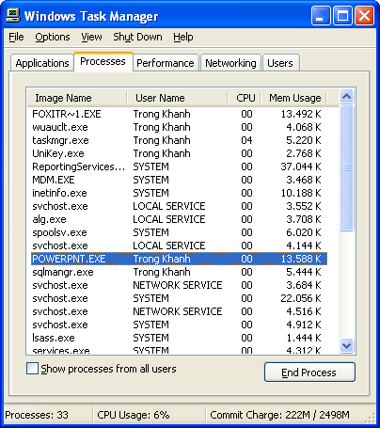
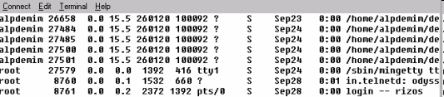
Concepts: Processes
What is the process? When do the process appear on?
Many processes exist at any time, do the many programs run in parallel? How do the OS manage them?

Slide 44
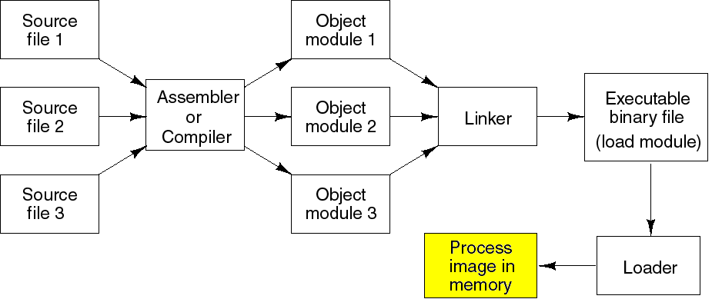
Concepts: Processes…
Process: A program in execution → Program: executable file is stored in a disk
For each process, OS allocates a set of resources such as memory blocks for executable code, data, stack, CPU registers value, PC, and other information needing to run a program → Each process has an unique address space (i.e., all memory locations that the process can read and write)
program
Steps for creating and running a program
sourcecode

Slide 45
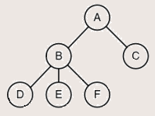
Concepts: Processes …
OS manages some processes → Information about processes must be maintained in the memory of the OS.
Process table (array or linked list) stores all the information of processes
A system consists of a collection of processes (many programs)
Based on this table, OS switches the CPU between processes
Process hierarchy (tree)
A process (parent) can create another processes, then the child process can create many processes, forming a process hierarchy
A process has only one parent, but it has zero, one, or more children.
A particular OS will implements this concept in different ways.
Tanenbaum, Fig. 1-13.

Slide 46
Concepts: Swapping Mechanism
Problems: The RAM capacity is limited, How does OS allow multiple programs loaded into memory? → Swapping mechanism.
* At a time, only one process holds the control (current process) → Memory map of a non-current process can be automatically swapped out of memory, and later swapped back to the memory at somewhere (OS will update the addresses if needed).
* Developer determine intentionally the absolute address of program located in the memory at the time (old programming model)

Slide 47
Concepts: Address Spaces
How OS can determine accessed address? → Address space
Address space: set of address values which can be accessed by a process.
Each process has it’s own address space.
An instruction of this process can not access an address of another (protection mechanism).
Make the different programs think they have the hardware on their own (protection mechanism).
Address space can be splitted into some decoupled (tách riêng) pages/segments. Each byte in a part is numbered from 0 to it’s maximum. Page/segment sizes can be various (larger or smaller).

Slide 48
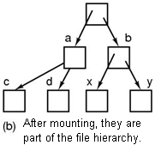
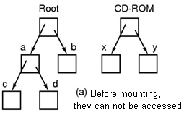
Concepts: Files
File: A collection of related information
It is an abstraction of data stored on HDD
Correlated information
path name, root directory, file descriptor (Windows)
Mounted file system: some file structures are linked to each other and are managed by OS.
Tanenbaum, Fig. 1-15 & 16.

Slide 49
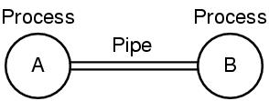
Concepts: Files
A pipe (UNIX)
A mechanism for passing data among processes
Is a sort of pseudofile that can be used to
connect 2 processes
Allows a child process to inherit a communication channel from its parent; data written to one end of the pipe can be read at the other.
Tanenbaum, Fig. 1-15 & 16.
write
read

Slide 50
Concepts: Files
Special files ( in UNIX): Make I/O devices look like file that are used for reading or writing (each IO device is identified by a file). These files associate with appropriate device drivers. They are classified into 2 kinds:
Block special files (ex. disks): Is one consisting of sequence of numbered blocks, each block can be individually (randomly) addressed and accessed (read/write using unit of block)
Character special files (Ex: printer, modem, mice, …)
Is used for devices that input or output a character stream (read/write using unit of character)
Cannot be randomly accessed (not block and not addressed)
Directory: a place to keep files/ a way of grouping files together.

Slide 51
Concepts: Input/Output
All computers have physical devices for acquiring input and producing output.
Some of them can be shared devices
Others can be dedicated devices
→ How does OS manage/manipulate I/O (physical) devices?
Every OS has an I/O subsystem for managing its I/O devices
Some of I/O softwares are device independent (standard devices).
Others are specific to particular I/O devices using device driver (non-standard devices)
→ OS uses the I/O softwares basing on I/O hardwares.

Slide 52
Concepts: Input/Output
Program
Program
OS Library
OS Library
Driver
Device
Device

Slide 53
Concepts: Protection
Is a mechanism for controlling accesses of processes or users on the resources defined by OS. It ensures that all access to system resources is controlled.
Protect the code of OS against the processes → Code of shell can not access address space of OS.
Protect one process against other processes → Code of a process can not access address space of others.
Can improve reliability be detecting latent(tiềm ẩn) errors at the interface between component subsystems
Techniques:
Authentication(việc xác thực), protecting the system from unwanted intruders (view of user managing)
Give attributes of file to protect the file accession → Each user can access a subset of the file system only.

Slide 54
Concepts: Shell
It is a piece of software (it is not a part of OS)that essentially provides a kind of interface for end-users to access the computer resource.
2 Types of shells:
Command intepreter. Command line interface: example: the Command prompt in Widows.
Graphical user interface (GUI): example: the Window Explorer, Gnome in Linux, KDE- K Desktop Environment
Although it is not part of the OS, it makes heavy use of many OS features
Many shells exist such as sh – Shell, csh – C Shell, ksh – Korn Shell, and bash – Bourne Again Shell (default shell in most Linux system).

Slide 55
Concepts: Shell…
Functionalities
Is started up (when user logs in) with prompt ($) character
Has the terminal as standard input and output
Shell scripts: A file containing a list of shell command they are executed in order (same as the bat file in DOS)

Slide 56
Ontogeny Recapitulates Phylogeny (Quá trình phát triển của OS)
Early computers had hardwired instruction sets
The instructions were executed directly by hardware and could not be changed (Not flexible)
Then came microprogramming (faster)
Large Memories
Had just over 128 KB (from 1959 to 1964) using assembly language
Have lots of memory nowadays (up to Gigabytes, Terabytes …)

Slide 57
Ontogeny Recapitulates Phylogeny (Quá trình phát triển của OS)
Protection Hardware
No protection hardware on IBM 7090/7094 so they just ran one program at a time, minicomputer and Intel 8080 – 80286 CPU running multiprogramming
Microcomputer protect hardware run ability multiprogramming at once.
Disks
Largely magnetic-tape based (no disks, no file system concepts)
First hard disk (by IBM in 1956) named RAMMAC (4m², store 5 million 7 bit characters, 35.000 $)
CDC 6600 in 1964 (permanent files)
In 1970, the standard disk with 2.5 MB (40cm diameter and 5cm high) had single directory
Floppy disk (512KB, 1.2MB, 1.4 MB …), Hard disk, Optical, Smart card ….

Slide 58
Ontogeny Recapitulates Phylogeny (Quá trình phát triển của OS)
Virtual Memory
Gives the ability to run programs larger than the machine’s physical memory by moving pieces back and forth between RAM and disk
Enabled the ability to have a program dynamically link on a library at run time instead of having it compiled in

Slide 59
5- System Calls
OS supports application programming interfaces (APIs – OS libraries) for accessing resources
Processes use APIs using system calls.
The interface between user programs and the OS (hidden to user)
Permit application programs to access protected resources
Making a system call is like making a special of procedure call located in the kernel.
Process <code>
…
…
// system call
Read( fp, buffer, nBytes)
…
…
User mode
OS < services>
Read( fp, buffer. nBytes)
<code>
Kernel mode
Hardware

Slide 60
System Calls
Events in a system call:
A process is running in user mode and needs a system service, it has to execute a trap instruction (interrupt) to transfer control to the OS (kernel mode).
The OS figures out what the calling process wants by inspecting the parameter, then it carries out the system call and returns the control to the instruction following the system call.

Slide 61
System Calls…
Steps in making a system call
Programs put the arguments in registers or on the stack (prepare to pass argument to OS function)
Then, it issues trap instructions to switch form user mode to kernel mode at the fixed address where the procedure located (OS saves the return position of the next instruction of the process).
The kernel mode dispatches to the correct system call handler (OS function executes).
When the system call handler has completed its work, the trap instructions is issued to switch form kernel to user mode.
Then, the procedure returns to the user program in the usual way procedure calls return.

Slide 62
System Calls…
System calls vs. System Programs
System programs provide a convenient environment for program development and execution (e.g, file manipulation, status, etc…)
System programs define the view of the OS seen by most users (they can be understood as shells)
Are a simply user interfaces to system call
Ex: Norton Commander, Window Exporer,…

Slide 63
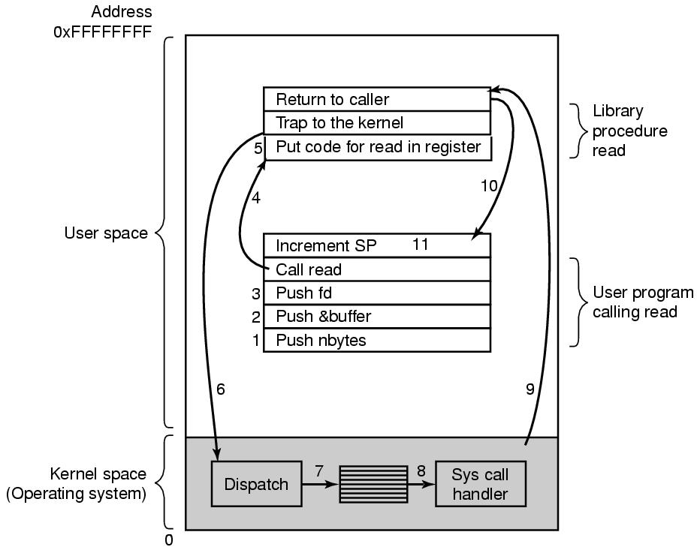
System Calls: Example
C, C++ compilers will put parameters to the stack in reverse order.
There are 11 steps executing the system call: read (fd, buffer, nbytes)
Tanenbaum, Fig. 1-17.

Slide 64
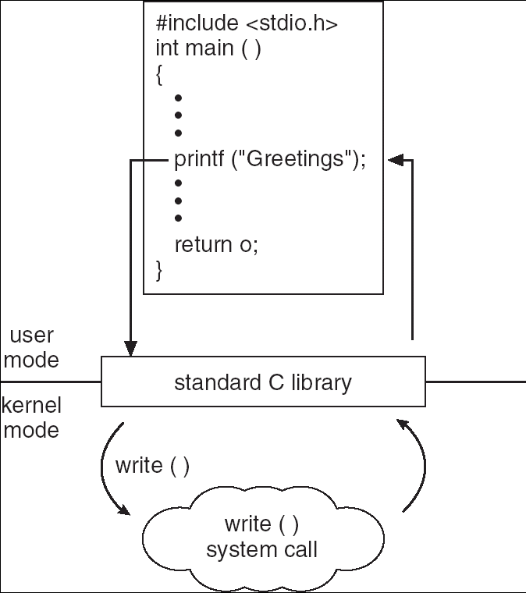
System Calls: Example

Slide 65
Some System Calls…
For Process Management:
- Create a child process - fork(),
Wait for a child process to terminate – waitpid(…)
Execute a process - exec(),
Terminate process and return status - exit(status) …
File management:
open(), close(), read(), write(), lseek(),
Get file status: stat()
…

Slide 66
Some System Calls…
For File System management:
mkdir(…), rmdir(…),
mount(…), unmount(…),
link(), unlink(), chown() - change file owner
…
Miscellaneous:
Change the working diretory: chdir(),
Change the file’s protection bits: chmod(),
Send a signal to a process: kill()
Get the elapsed time since Jan, 1, 1970: time()
….

Slide 67
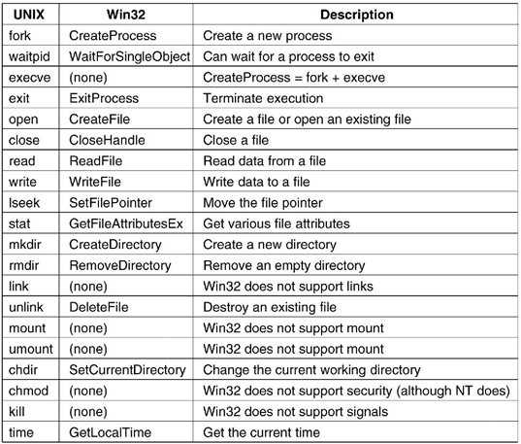
Some System Calls…
UNIX System Calls vs Windows Win32 API
Tanenbaum, Fig. 1-23.

Slide 68
6- OS Structure
Monolithic Systems – Hệ nguyên khối
Layered Systems – Hệ phân lớp
Micro Kernels – Hệ vi nhân
Client-Server Model
Virtual Machines: Máy ảo
Exokernels: Trình quản lý tài nguyên trong hệ thống nhiều máy ảo.
Notes:
ủa các máy ảo

Slide 69
OS Structure: Monolithic Systems
The entire OS runs as a single program in kernel mode
The OS is written as a collection of procedures, linked together into a single large executable binary program.
A basic structure
A main program that invokes the requested service procedure.
A set of service procedures that carry out the system calls.
For each system call there is one service procedure that takes care of it and executes it.
A set of utility procedures that
Help the service procedures.
Do things that are needed by several service procedures (e.g fetch data)
Tanenbaum, Fig. 1-24.

Slide 70
OS Structure: Monolithic Systems…
Disadvantages
Run only on one single large executable binary program (not flexibility)
Do not protection, but hide information
The system is free to call any other ones
Can uses low level language (assembly)
Having thousands of procedure can call each other
Using procedure (static) → cannot manage user environments
Advantages
Simple (→ running fast)
Ex: MS-DOS

Slide 71
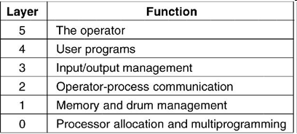
OS Structure: Layered Systems
The OS is broken up into a number of layer, each built on top of lower
Assuming that the bottom layer is the hardware, and the highest layer is the user interface, layers are selected so that each one uses functions, operations and services of only lower-level layers.
Lower layers (usually called the kernel) contains the most fundamental functions to manage system resources.
There are 6 layers:
Tanenbaum, Fig. 1-25.

Slide 72
OS Structure: Layered Systems
Disadvantages
How many layers?
What’re functions?
Slow
Advantages
Easy to maintain, support, manage errors
Modularity, encapsulation
Ex: OS/2, Windows NT, Vista and Unix

Slide 73
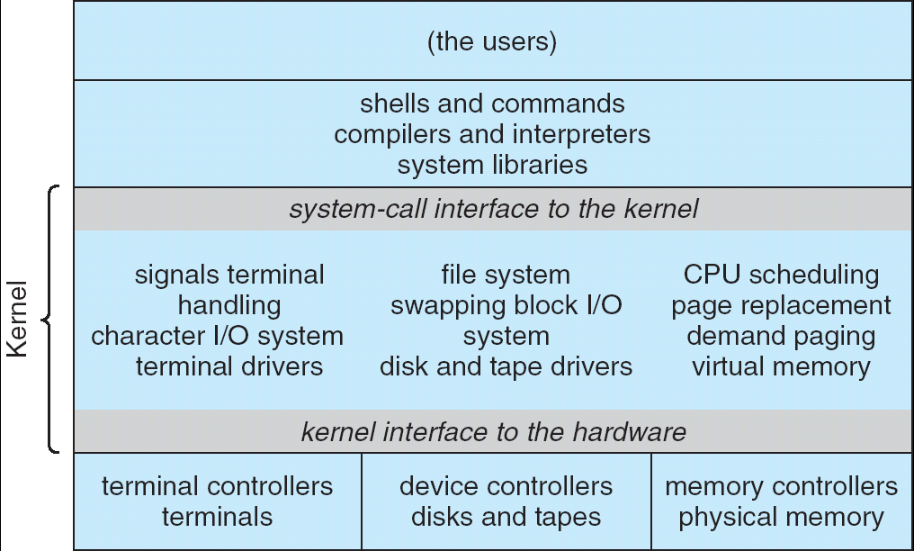
OS Structure: Microkernels
OS Kernels have problems
10 bugs/ 1000 lines code (buggy, bring down the system)
All the layers went in the kernel (complexity, large, and difficult to manage)

Slide 74
OS Structure:Microkernels…
Microkernels
Remove all nonessential components from the kernel, and implement them on user mode (splitting the OS into small, well-defined modules)
Running each task as an independent (separate) process → resist (chịu được) crashing the entire system
The modules run user mode → protection against bugs
Making a minimal kernel by put the mechanism for doing something in the kernel but not the policy (scheduling with highest priority process)
Provide a communication facility using message passing between the client program and the various series in user mode

Slide 75
OS Structure:Microkernels…
Disadvantages
How to define the components are nonessential or essential? (depending on the design ideas or requirements).
Performance overhead of user space to kernel space communication.
Advantages
Easy of extending and port the operating system to new architectures.
Advance security and reliability (less code is running in kernel mode).
Ex: Symbian, Apple MacOS X Server.

Slide 76
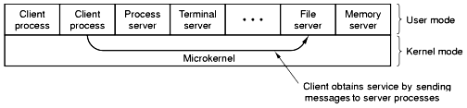
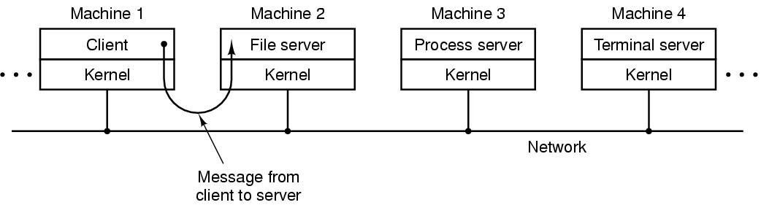
OS Structure: Client–Server Model
Server provides some service that satisfy the client’s request
Client uses the server’s services
Message passing is used to communication
Can run on different or same computers
Tanenbaum, Fig. 1-27.

Slide 77
OS Structure: Virtual Machines (VM)
Each virtual machine
Are not extended machine but all hardware are abstracted by codes.
Is identical to the true hardware (provide an exact duplicate of the underlying real machine)
Can run any OS that will run directly on the bare hardware
Different VMs can run different OS
Supports to run more OSs at the same time (Windows, Linux)
Softwares:
VMware Workstation
OS running on CD (Linux, Ubuntu …)
JVM (Java Virtual Machine):
Java compiler produces code through Java interpreter.
Can be shipped on Internet and run on the computer that has a JVM.

Slide 78
OS Structure: VM…
Advantages:
Completely protecting system resources
Solving system compatibility system and
do not disrupt(phá vỡ) the normal system operation
Disadvantages:
can not allocate all disks to VM

Slide 79
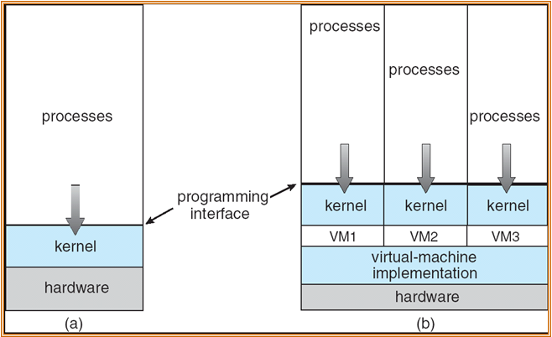
OS Structure: VM…
(a) Nonvirtual machine
(b) virtual machine
Virtual-machine implementation is called virtual machine monitor, or virtualization layer, or hypervisor

Slide 80
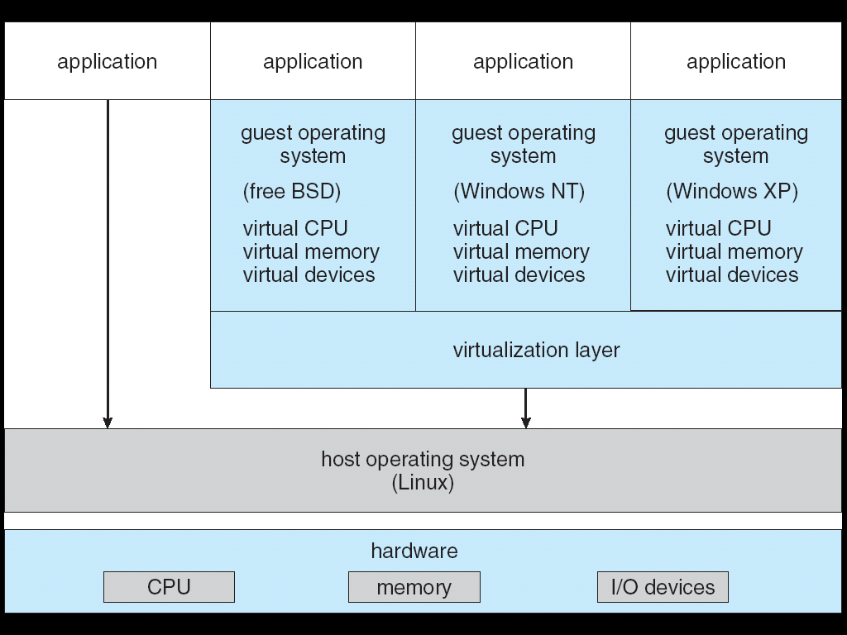
OS Structure: VM…
Berkeley Software Distribution. A UNIX version developed at the University of California at Berkeley, providing additional capabilities such as networking, extra peripheral support, and use of extended filenames.
VMWare Architecture

Slide 81
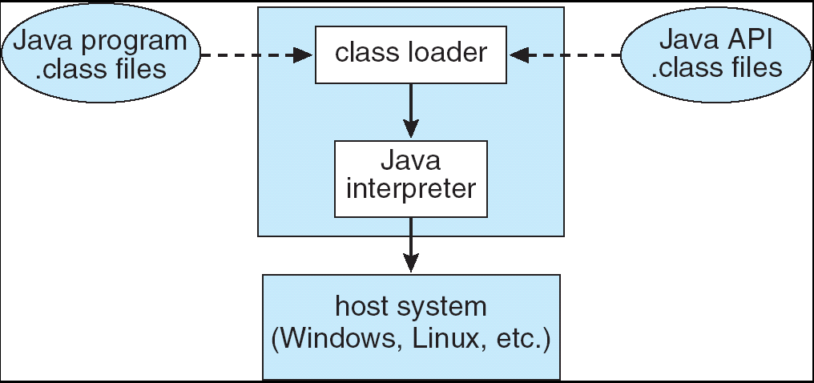
OS Structure: VM…
Java Virtual Machine - JVM

Slide 82
OS Structure: Exokernels
Is a program running in kernel mode
It partitions the machine and gives each user a subset of the resource (instead of exact copies entire of underlying real machine)
Allocate resources to virtual machines and ensure the protection of them.
Moreover, exokernels make the VM thinking that it has its own disk (0 to maximum size of partition area)
Advantages
The exokernel scheme is saved a layer mapping
Need keep track of which virtual machine has been assigned which resource
Separate the multiprogramming in user mode (protection from real machine) with less overhead.
Notes:
Exo : out of, outside

Slide 83
Summary
Operating System Concepts
System Calls
OS Structures
Q&A

Slide 84
Keep in your mind
User mode
Kernel mode
What is operating systems
What are roles of an OS?
What are goals of an OS?
When does a mode switching occur?
What is a main frame?
What is a batch processing?
How does OS support multitasking?
What is a hard real –time system?
What is a soft real –time system?
What is a process?
What is the processs table?
What is a process hierarchy?
With respect to memory, how does an OS allow loading mutiple programs?
What is address space of a process?
What is a pipe in the Unix OS?
What is special files?
What are special file types?
Protection is ……
What are shells of an OS?
What is a system call?
What is a monolithnic OS? Give an example.
What is a layerred OS? Give an example.
What is a virtual machine?

